Slide 1
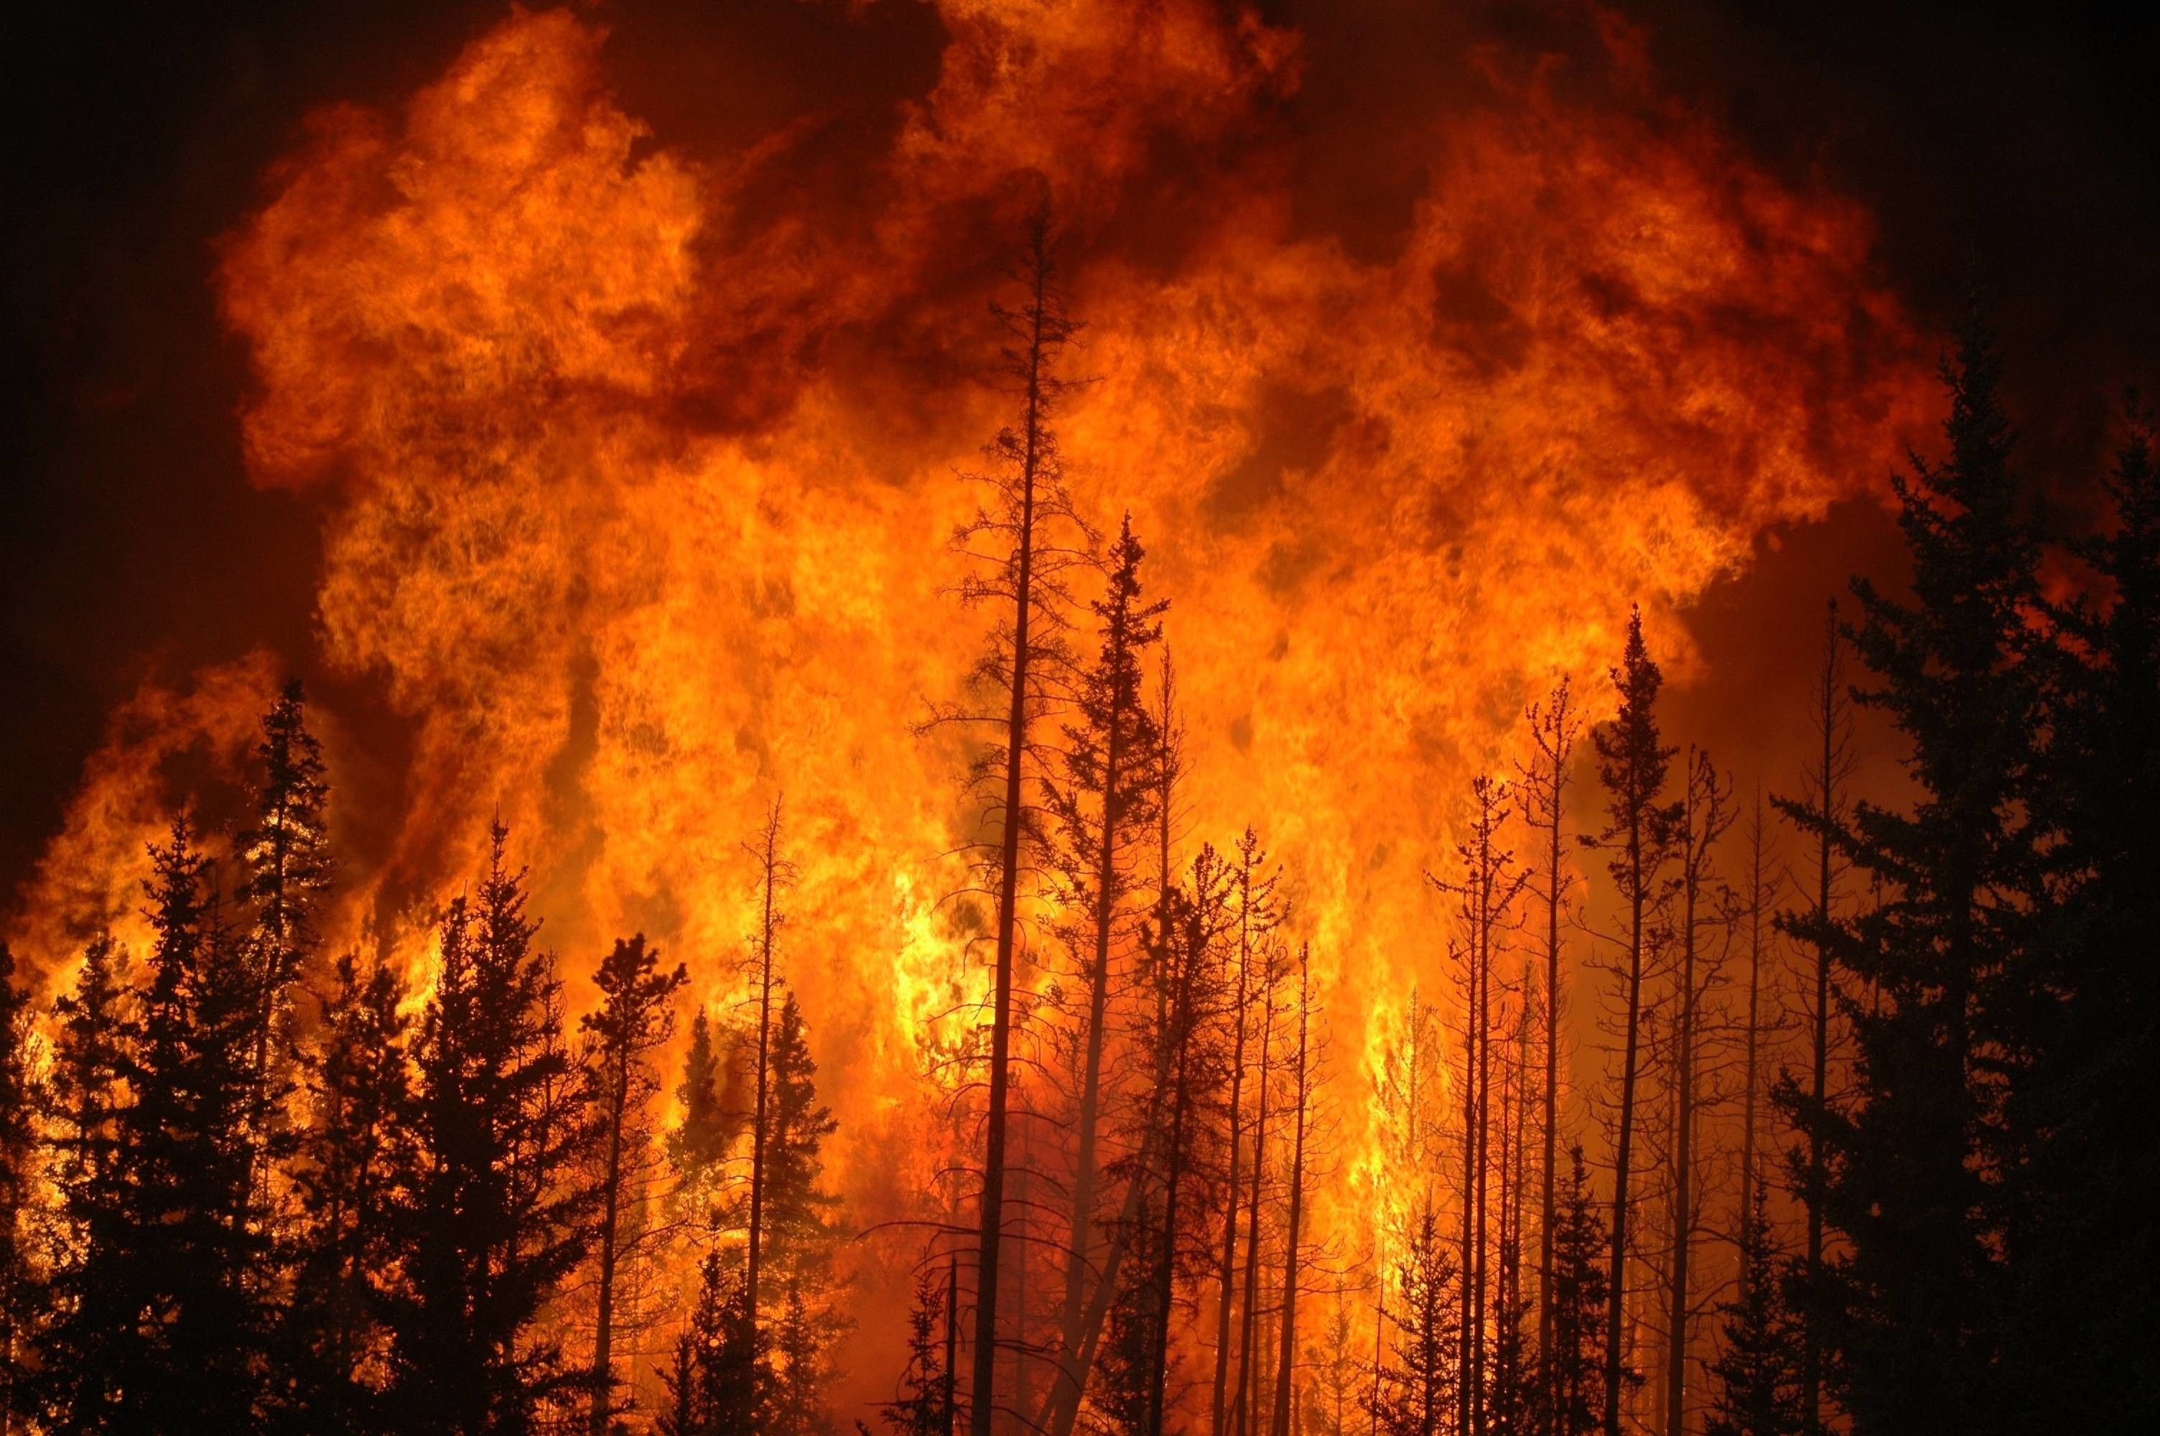
FOREST FIRE DETECTION

Slide 2
Team Details
NOHITH B
KARTHIK REDDY M
VIGNESH SUPRITH B

Slide 3
Finding an accurate Dataset and Importing necessary libraries and tools.
By : Nohith B
2000050004
Data Pre-Processing and Data Cleaning steps done for the purpose of filtering data.
By : Karthik Reddy M
2000090022
The most important part for the representation of data which is Data Visualization.
By : Vignesh Suprith B
2000090042

Slide 4



Introduction
Fire can make major hazards in this hectic world. All buildings and vehicles used in public transportation have fire prevention and fire protection systems due to the accelerated number in the fire incidents. Also, many of the firms conduct a mock fire drill in every occurrence of months to protect their employees from the fire.

Slide 5

REVIEW-I
EXPLORATORY DATA ANALYSIS

Slide 6
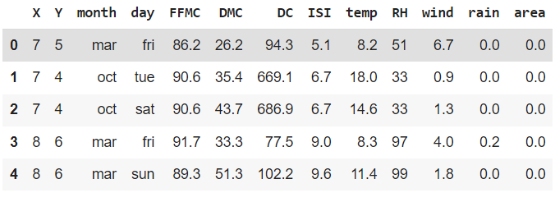
ATTRIBUTE TABLE
WE HAVE 13 ATTRIBUTES IN OUR DATASET

Slide 7

DATA VISUALIZATION USING GRAPHICAL REPRESENTATIONS

Slide 8
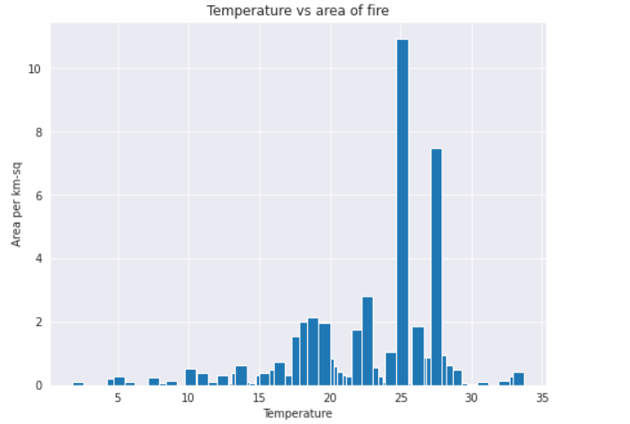
BAR GRAPH TELLS US ABOUT TEMPERATURES

Slide 9
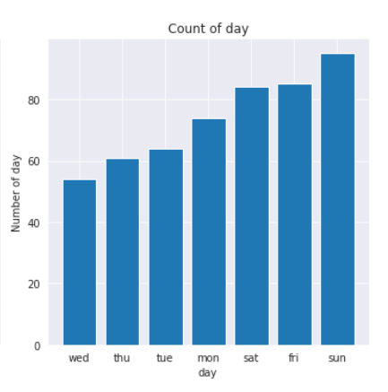
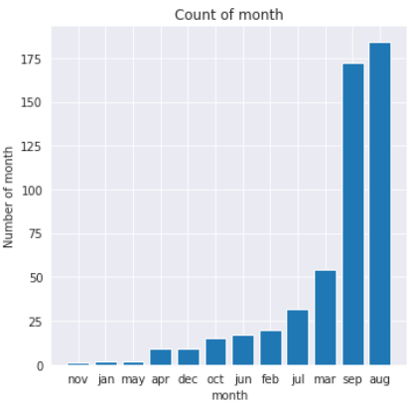
BAR GRAPH TELLS US ABOUT COUNT OF FOREST FIRES
COUNT BASED ON DAYS
COUNT BASED ON MONTH

Slide 10
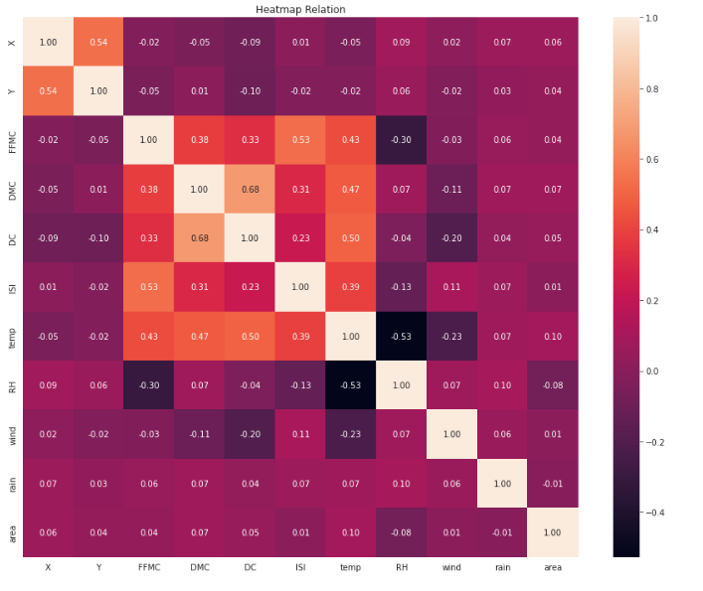
HEAT MAP BASED ON THE CORRELATION MATRIX

Slide 11
fig = plt.figure(figsize=(10,5))
residuals = (y_test-predictions)
sns.distplot(residuals)

Slide 12
fig = plt.figure(figsize=(10,5))
residuals = (y_test-predictions)
sns.distplot(residuals)

Slide 13
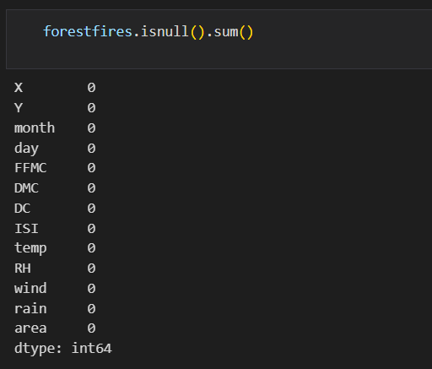
CHECKING FOR THE NULL VALUES

Slide 14
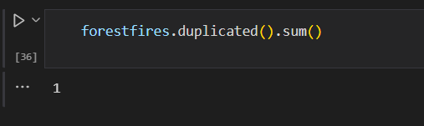
ONE DUPLICATE VALUE FOUND

Slide 15

SINCE WE FOUND THE DUPLICATE VALUE WE WILL REMOVE IT.

Slide 16
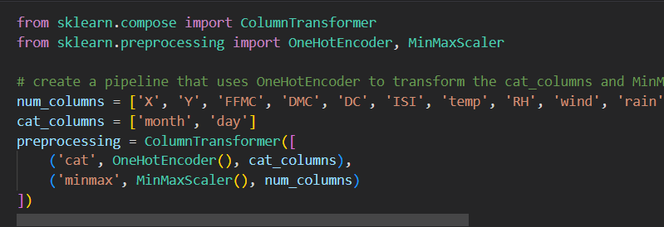
ONE HOT ENCODING ON DATE_COLUMNS

Slide 17
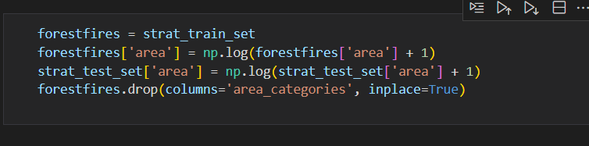
DROP UNWANTED COLUMNS

Slide 18
MODEL BUILDING
REVIEW-3

Slide 19
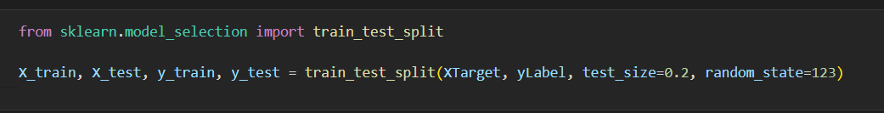
SPLITTING THE DATASET
We choose to split the dataset into as:
Training data : 80%
Testing data :20%
These assumptions are taken because these are the best suitable splitting.

Slide 20
WHICH MODEL AND WHY?
We choose to build the linear regression model for our MODEL BUILDING process.
Linear regression is used because our data is linearly dependent on the other variables so the best option is Linear Regression
In linear regression based on the variables and the dependencies of the variables the model predicts the outcome

Slide 21
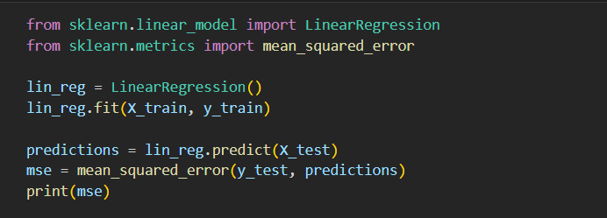
LINEAR REGRESSION MODEL
WE IMPORTED THE LINEAR REGRESSON MODEL DIRECTLY FROM THE SKLEARN LINEAR MODEL

Slide 22
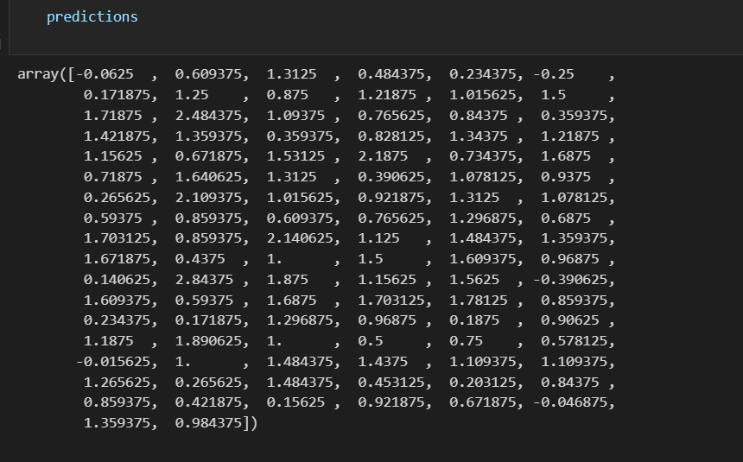
PREDICTIONS
THESE ARE THE PREDICTIONS THAT WE GOT FOR THE TESTING DATA.

Slide 23
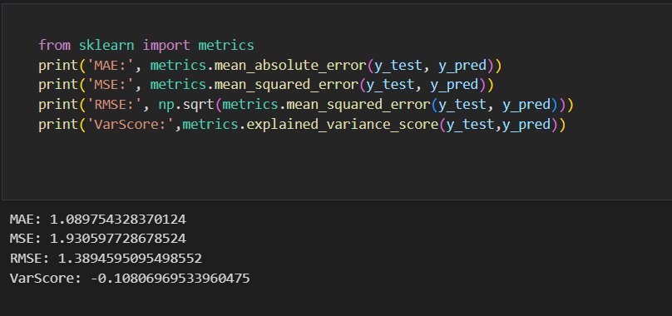
PERFORMANCE METRICES
THE PERFORMANCE METRICES WE CHOOSE ARE MSE, MAE for checking the accuracy of model.
We choose the MSE AND MAE instead of confusion matrix because in regression we predict number but not classify the output.

Slide 24
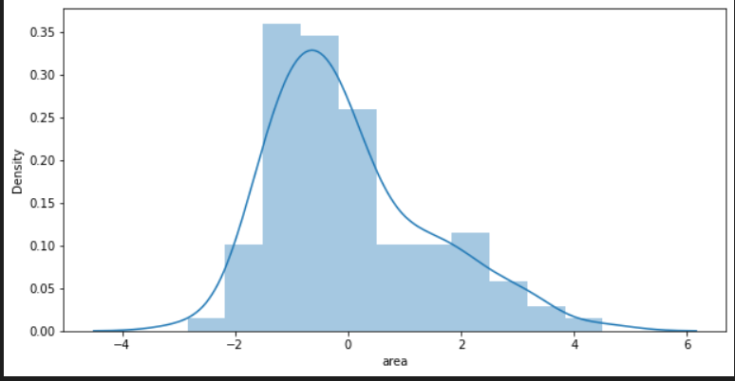
THE OUTPUT VISUALIZATION
The above visualization represents the ERROR rate for the model.

